Slide 1
Economic Networks in the Light of the Recent Supply-Chain Crises Data: A range of economic data, including input-output tables
Stat 222, Spring 2022
UC Berkeley, Statistics

Slide 2
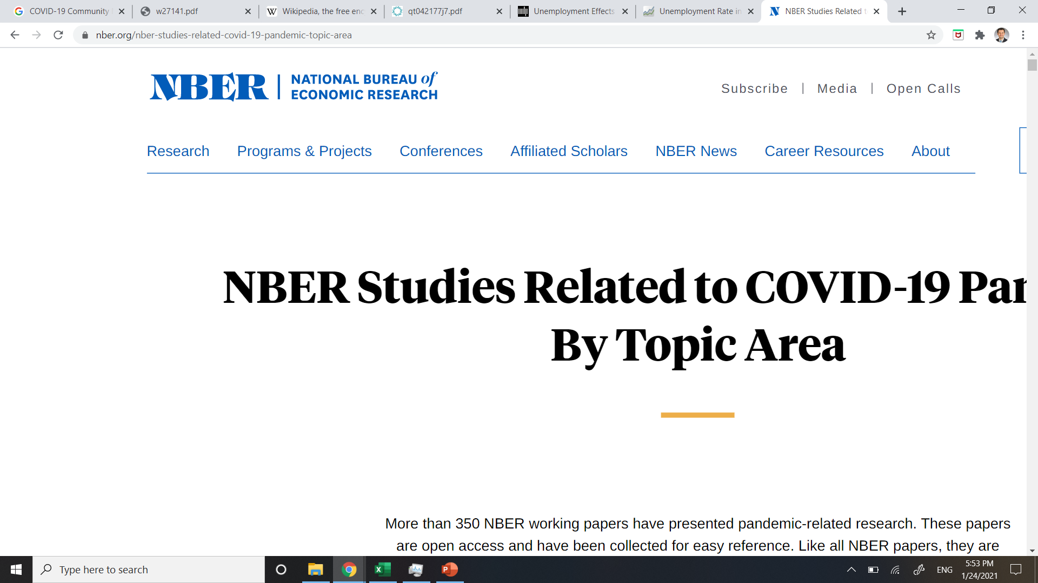
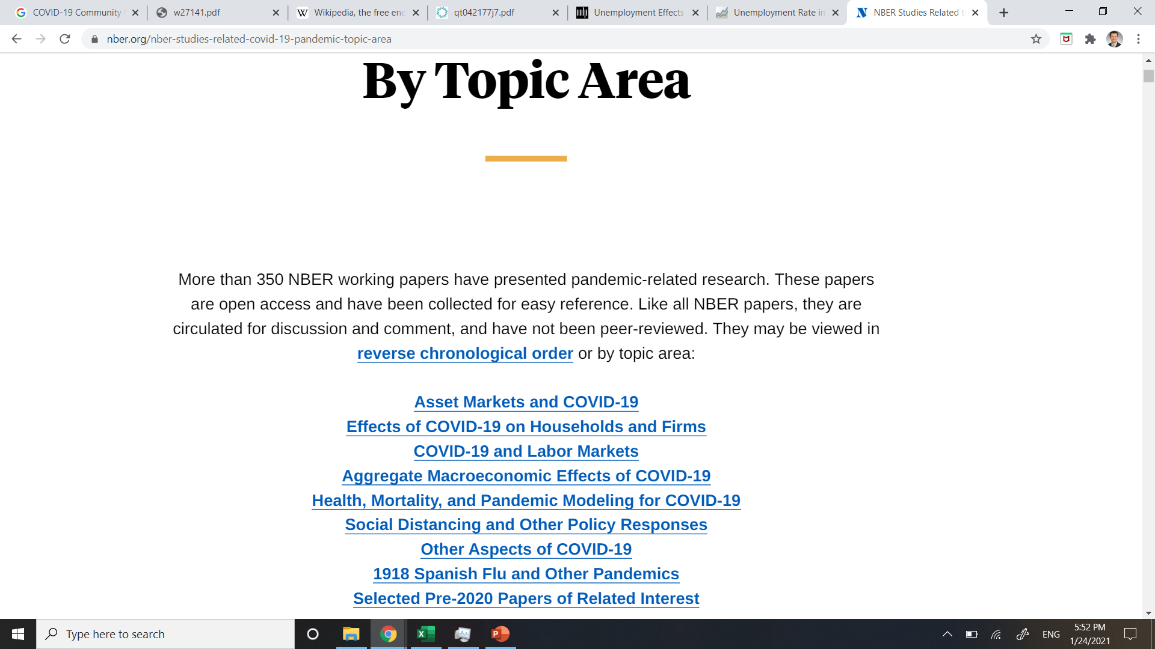
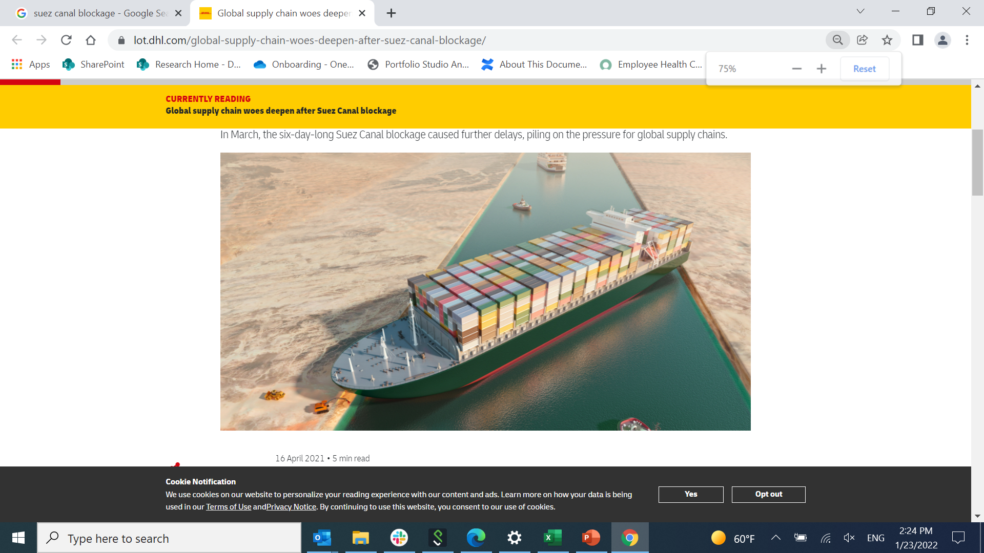
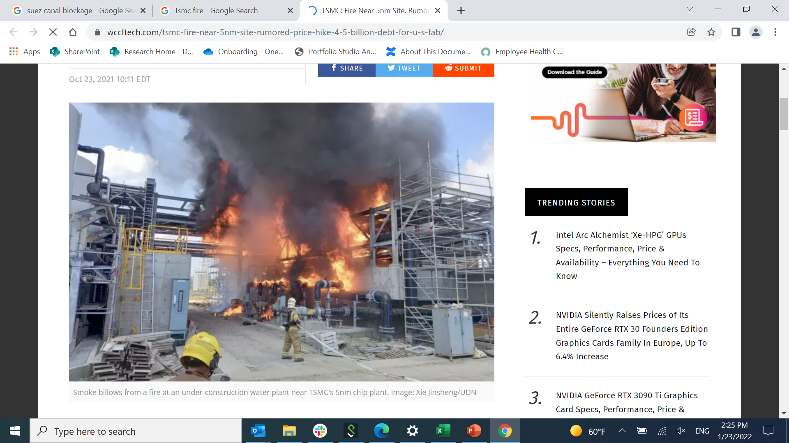
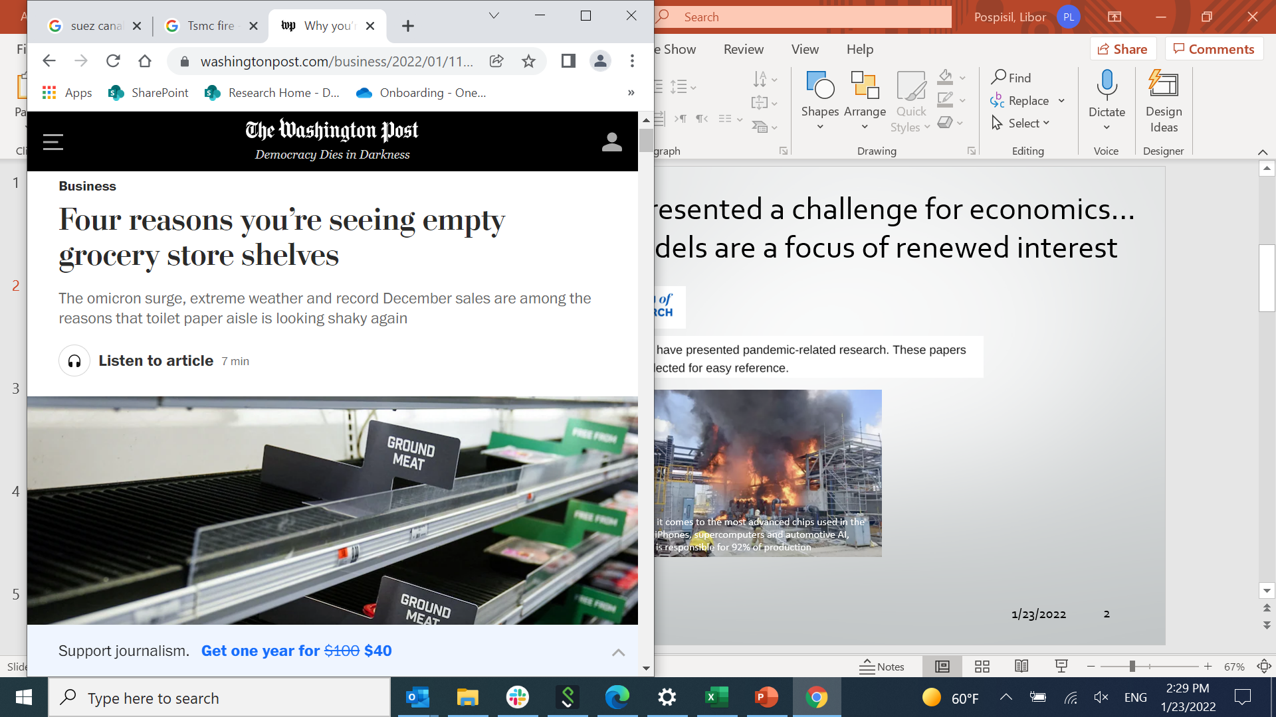
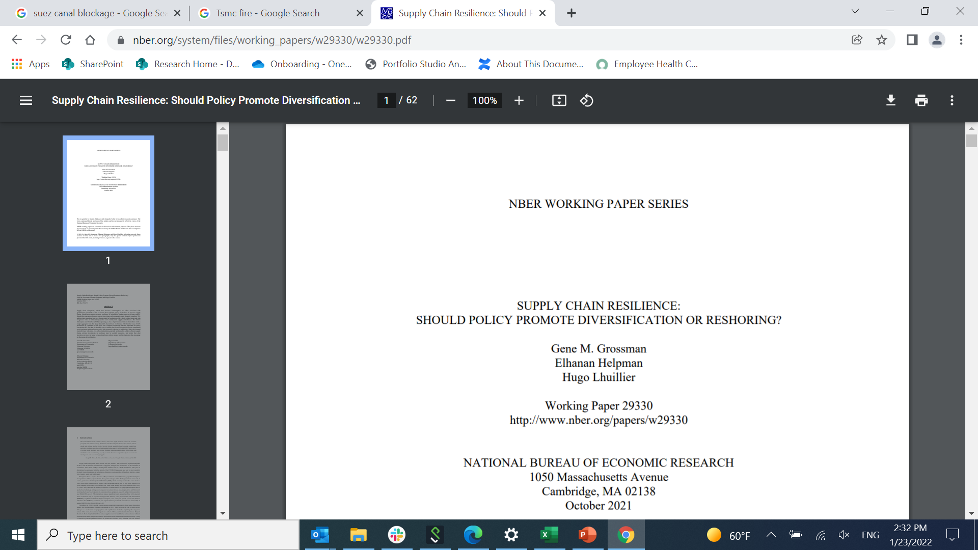
COVID-19 has presented a challenge for economics... some older models are a focus of renewed interest
When it comes to the most advanced chips used in the latest iPhones, supercomputers and automotive AI, TSMC is responsible for 92% of production

Slide 3
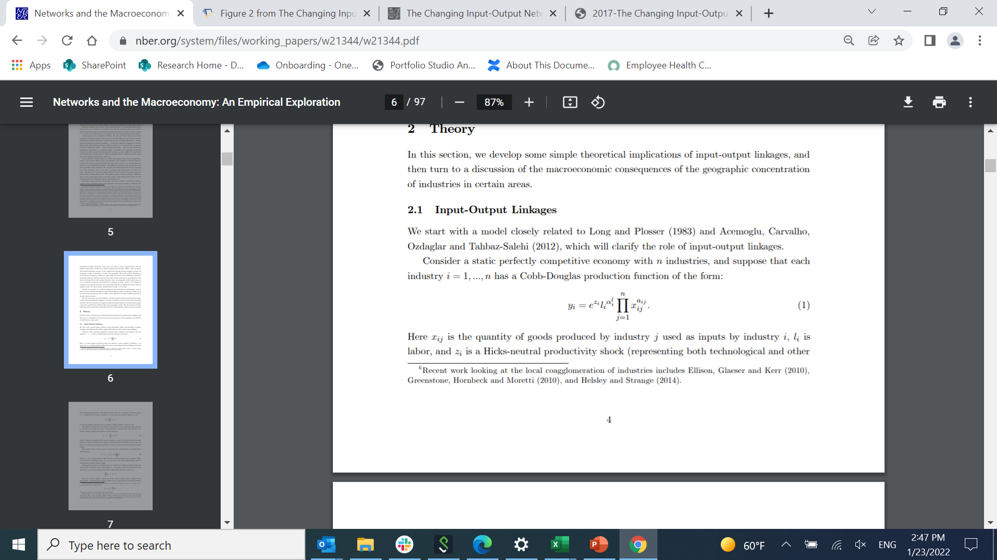
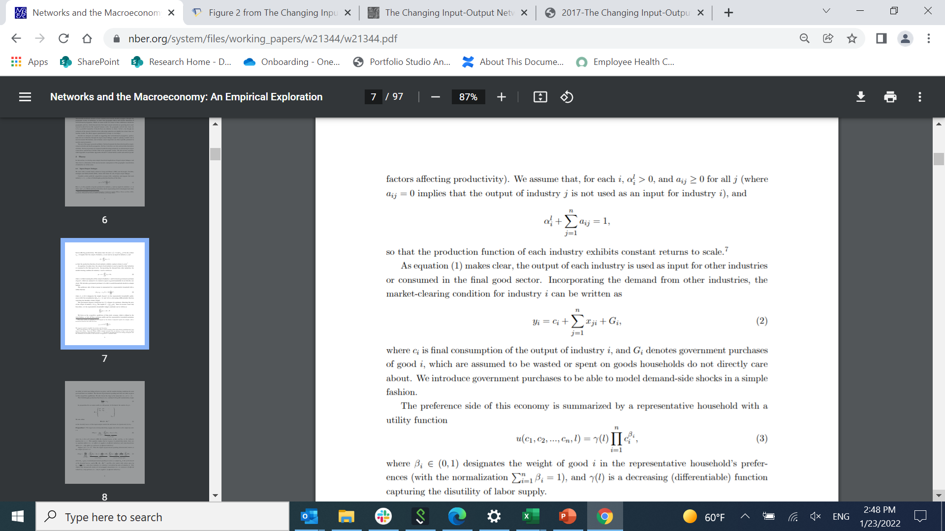
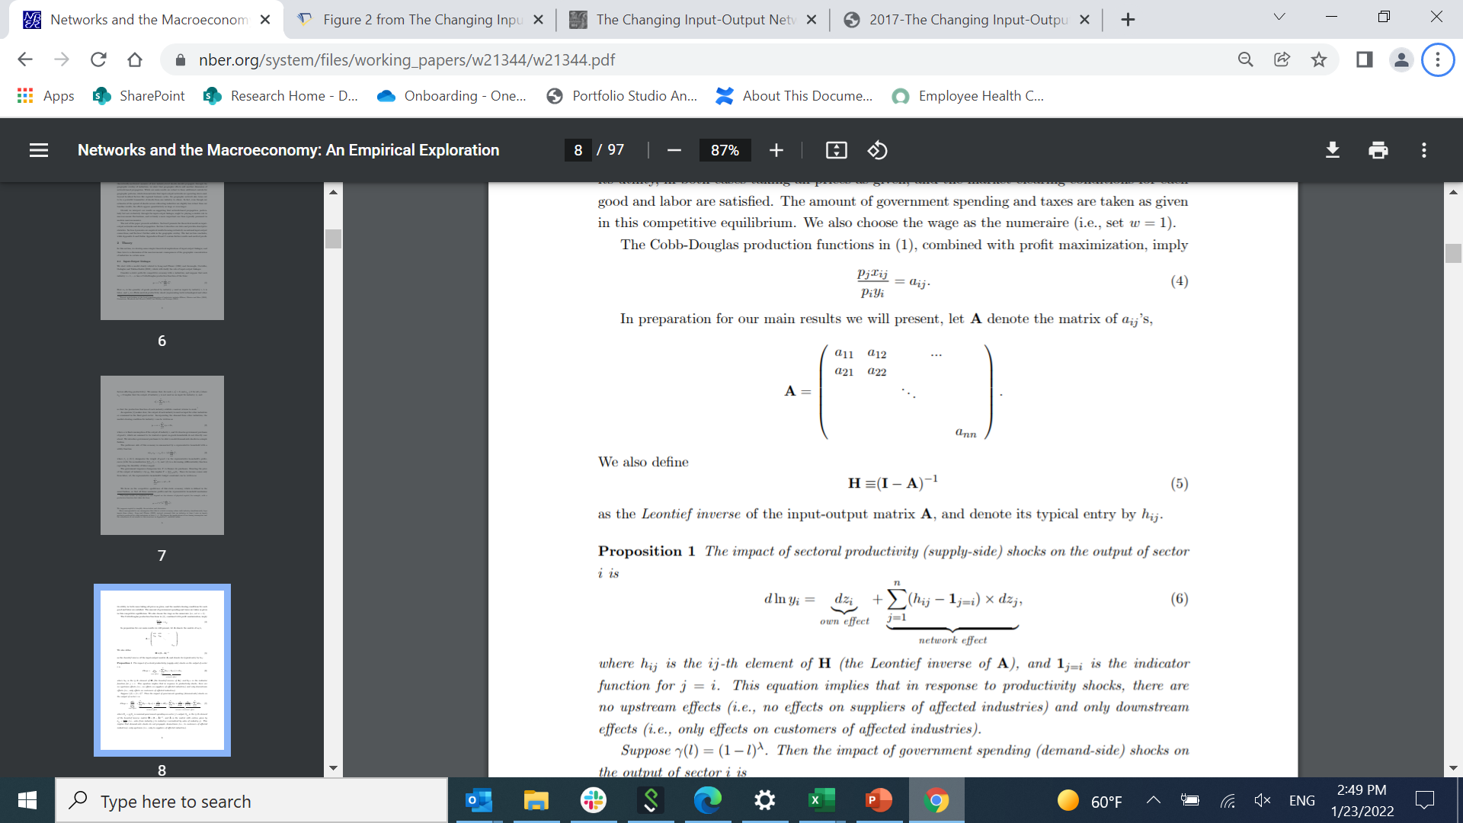
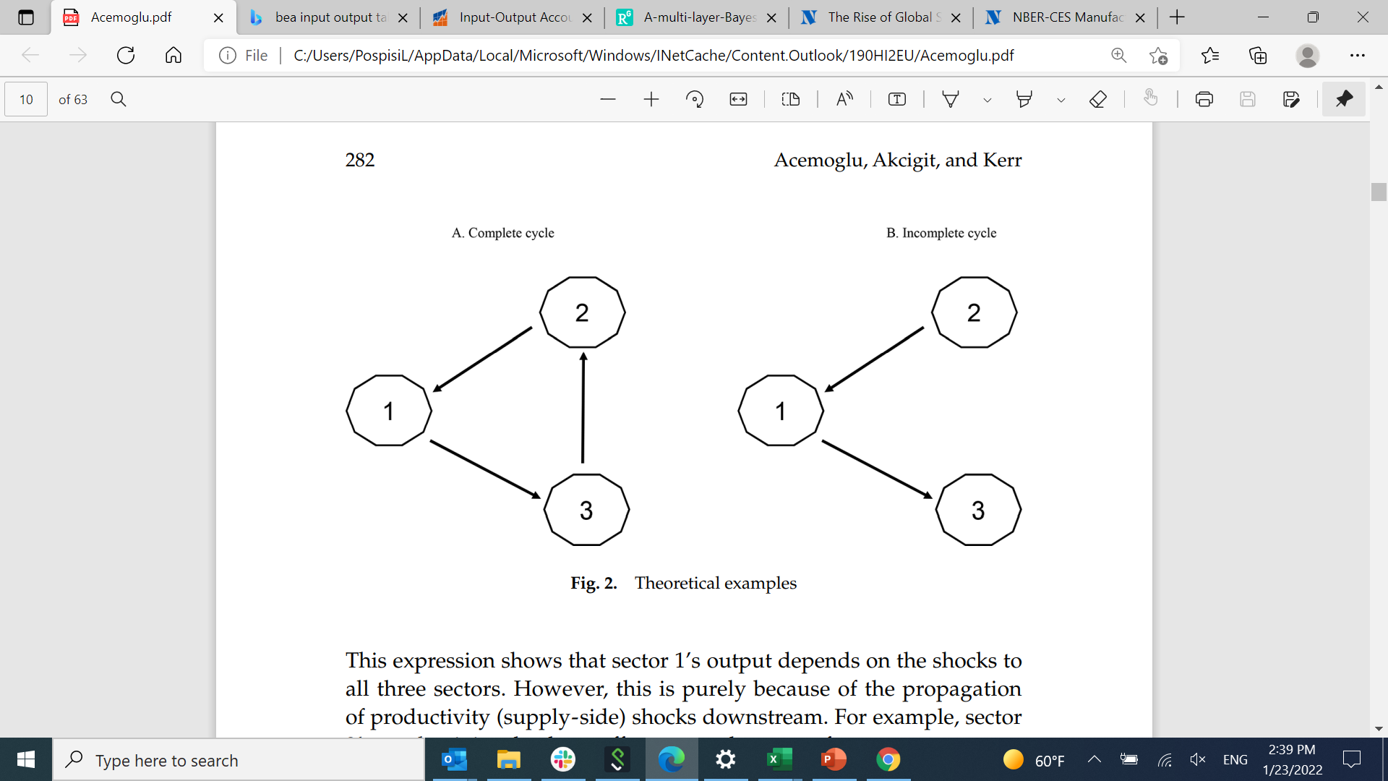
Theoretical framework
https://www.nber.org/system/files/working_papers/w21344/w21344.pdf

Slide 4
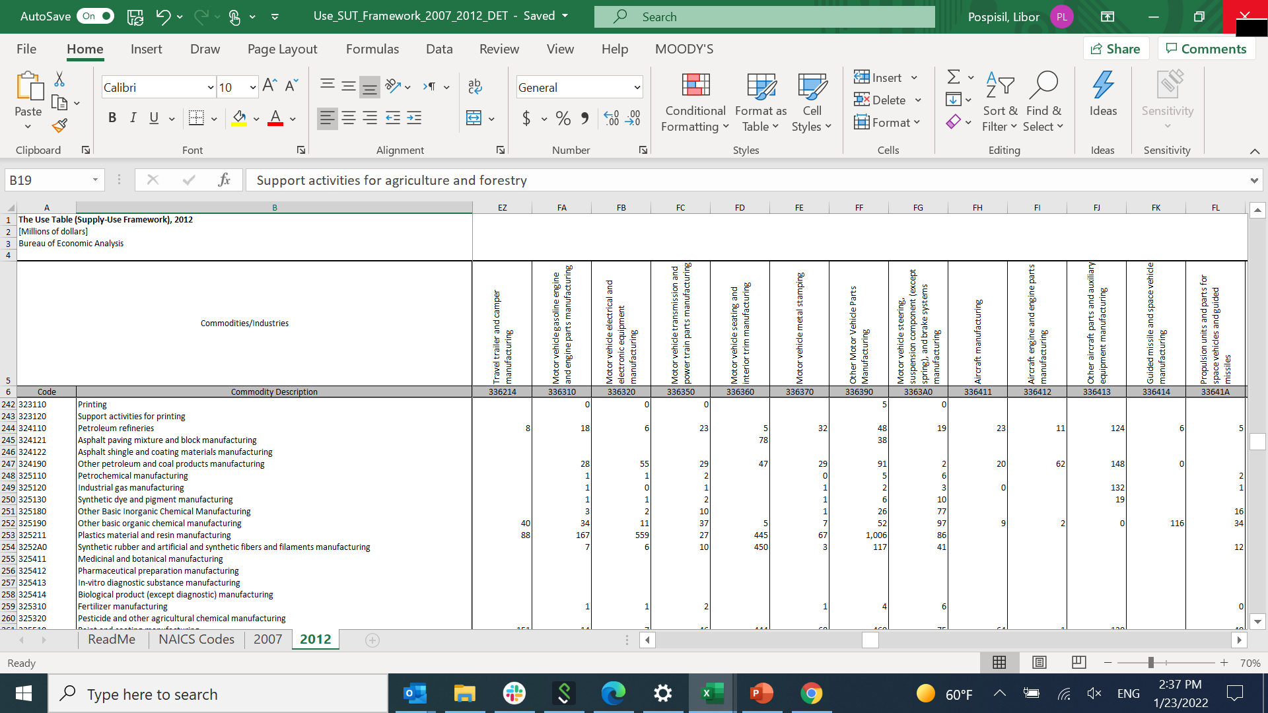
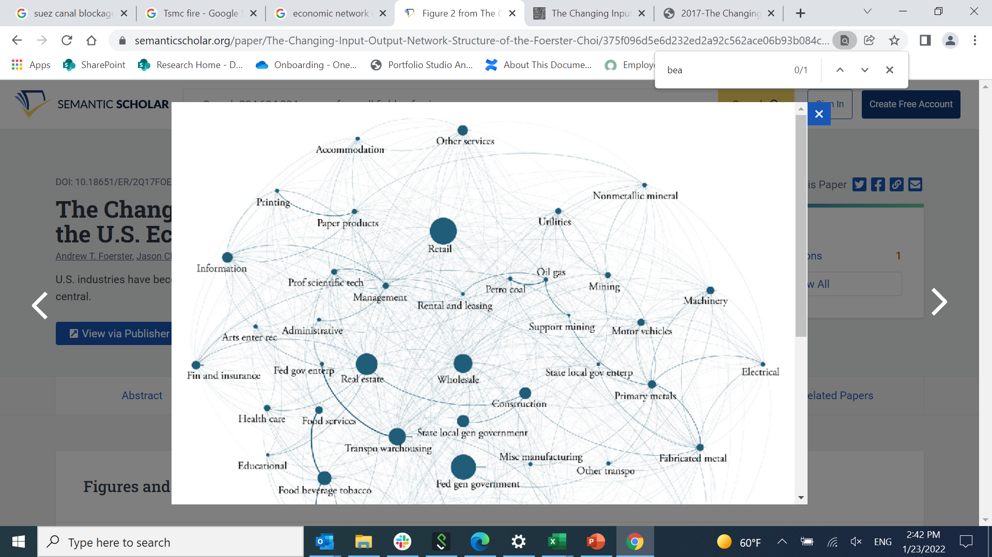
Input – Output Table
https://www.bea.gov/industry/input-output-accounts-data
https://www.kansascityfed.org/documents/631/2017-The%20Changing%20Input-Output%20Network%20Structure%20of%20the%20U.S.%20Economy.pdf

Slide 5
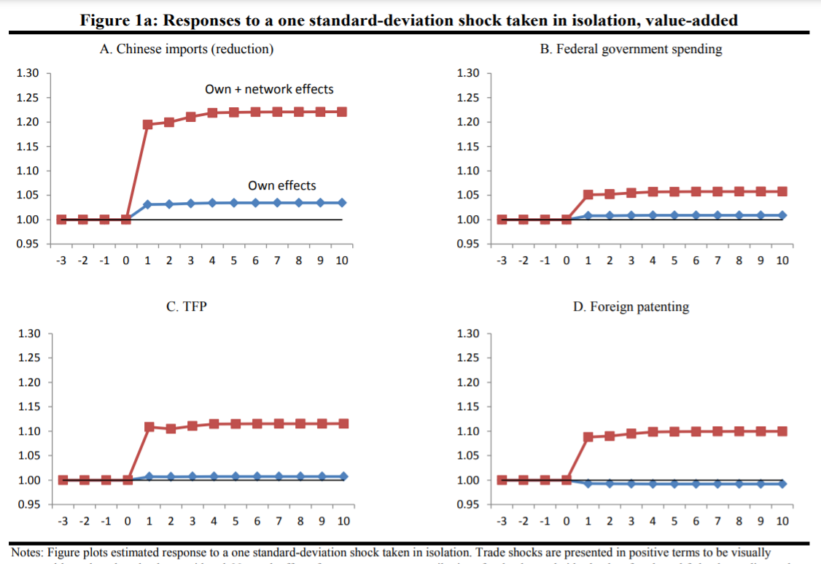
What are these models for?
Responses of economic variables to various scenarios – define COVID-19 related scenarios; or scenarios related to recent supply-chain shocks
Further data used:
NBER-CES Manufacturing Industry Database | NBER
https://www.nber.org/research/data/nber-ces-manufacturing-industry-database

Slide 6
A project
Formulate the purpose of your project – for example:
Designing & calibrating an economic network to understand how potential shocks, such as disruption in a certain industry, can impact other sectors.
This can be used by companies/governments to increase resiliency of their sectors/economies.
What the project would involve:
Familiarizing yourself with the existing literature of economic networks.
Setting the domain for your project – US economy at the industry level; or the global economy at the country level.
Handling the data – input-output tables (sparse, incomplete, and some parts do not completely describe the relationships), economic data.
Based on existing literature, design a model that would propagate economic shocks through the network.
Calibrating the network model while working out numerous statistical issues. (Incl. stability of Leontief inverse).
The calibrated model needs to follow economic intuition.
Validating/benchmarking the model.
Presenting examples of use of the model to relate the results to the original purpose. Define scenarios of shocks and demonstrate their impact.
Other potential avenues: predict productivity or other econ variables at the industry level, knowing the past values of the variables and the macroeconomic environment. In light of the supply-chain shocks, do the input-output tables contribute to the prediction?

